Slide 1
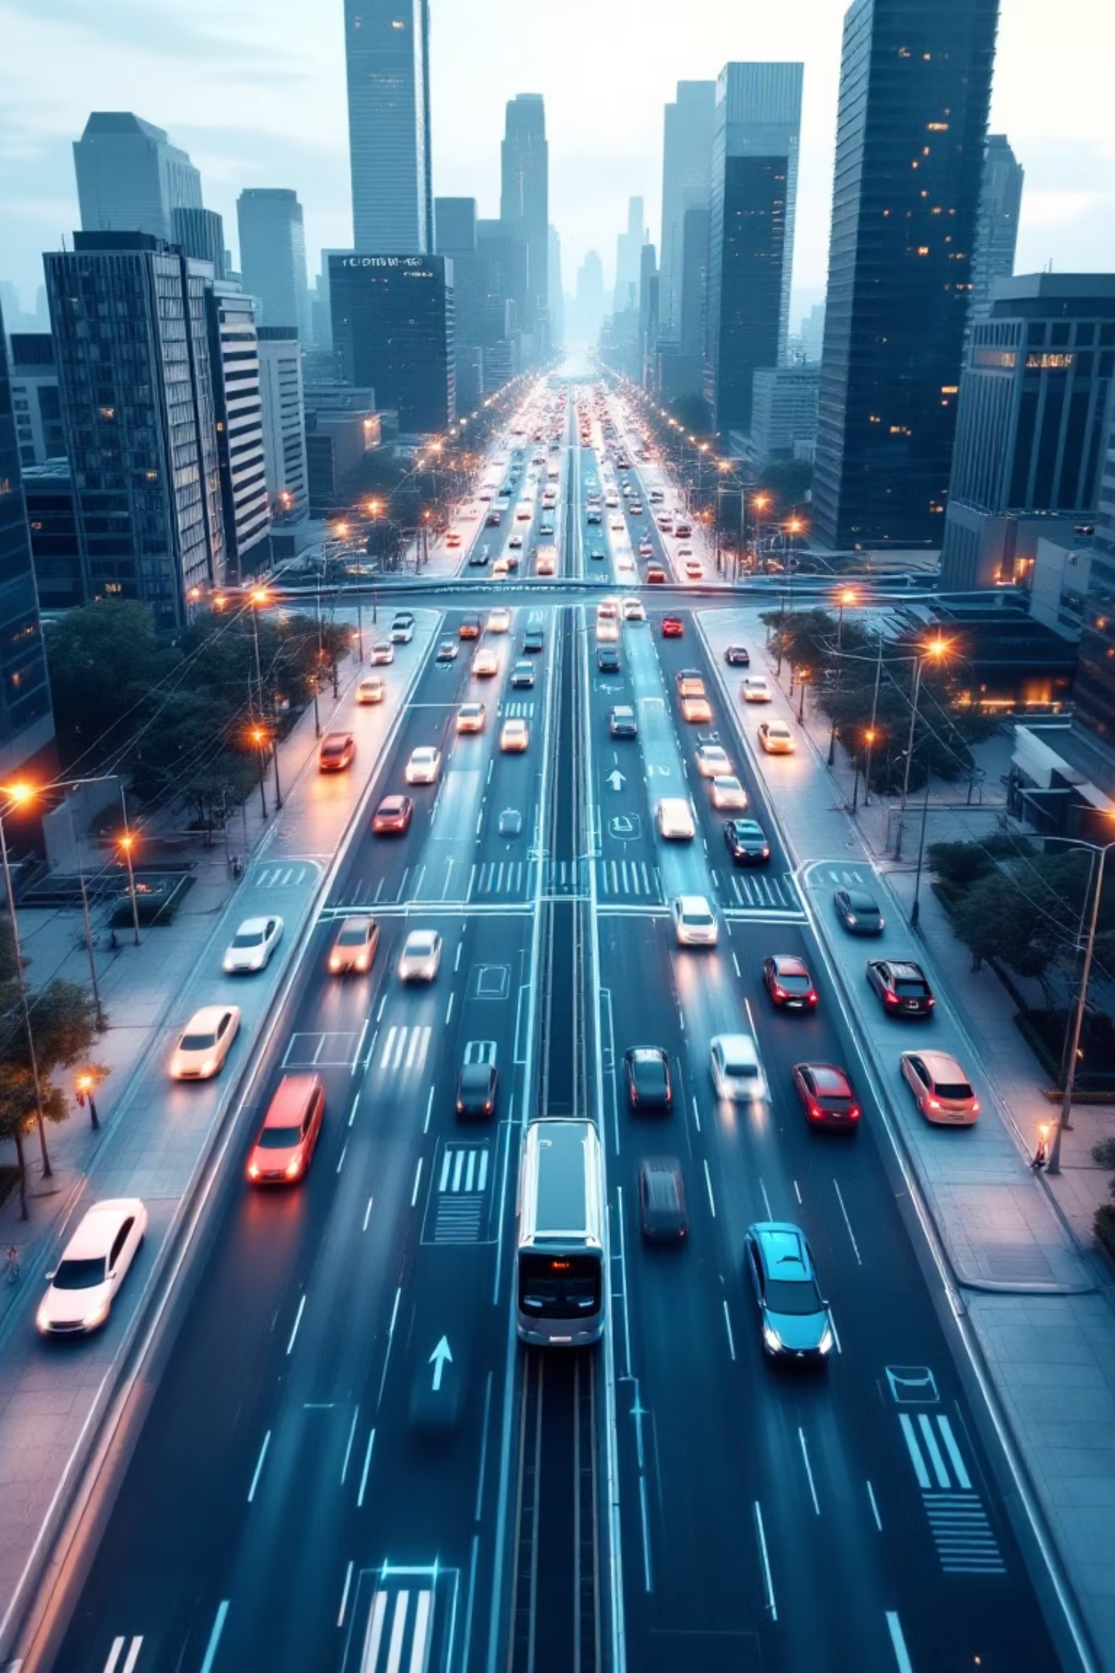
TrafficTelligence: Advanced Traffic Volume Estimation
Welcome, city planners and technologists. Our presentation introduces TrafficTelligence, an innovative solution designed to revolutionize urban traffic management through advanced machine learning.
Team Members:
Team Leader : P Subhan Khan
Team member : Patan Afroz Khan
Team member : Pendekal Yamuna
Team member : Pinjari Mohammad Zubair

Slide 2


The Core Problem: Urban Traffic Congestion
Urban areas are increasingly plagued by severe traffic congestion, leading to significant economic losses, environmental pollution, and reduced quality of life. Current traffic management systems often rely on outdated infrastructure, proving expensive to maintain and lacking the real-time adaptability necessary for effective traffic flow optimization. This limits city planners' ability to respond dynamically to changing conditions and implement proactive solutions.

Slide 3

Our Objective & Key Audiences
Objective
To develop a robust, machine learning-based system capable of estimating traffic volume in real-time, providing actionable insights for dynamic traffic management.
Target Audience
City Traffic Departments
Urban Planners
Smart City Developers
Navigation Application Providers

Slide 4

TrafficTelligence: Solution Overview
TrafficTelligence employs cutting-edge machine learning algorithms to accurately predict traffic volume. By integrating diverse data inputs from CCTV cameras, GPS devices, and a network of street-level sensors, our system provides a comprehensive and adaptive understanding of traffic dynamics. This enables more precise, scalable, and responsive predictions, leading to improved urban mobility and reduced congestion.

Slide 5
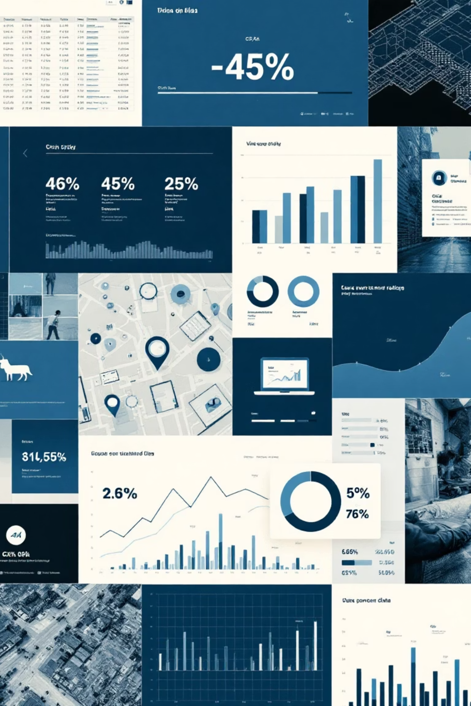
Comprehensive Dataset Description
Diverse Data Sources
We utilize a combination of publicly available open datasets and carefully simulated traffic data to ensure broad applicability and robustness in our models.
Varied Data Types
Our input includes structured data such as CSV files, granular GPS logs from vehicles, and rich video footage from surveillance cameras.
Rigorous Preprocessing
All data undergoes extensive cleaning, normalization to standardize formats, and intelligent feature extraction to optimize it for machine learning algorithms.

Slide 6

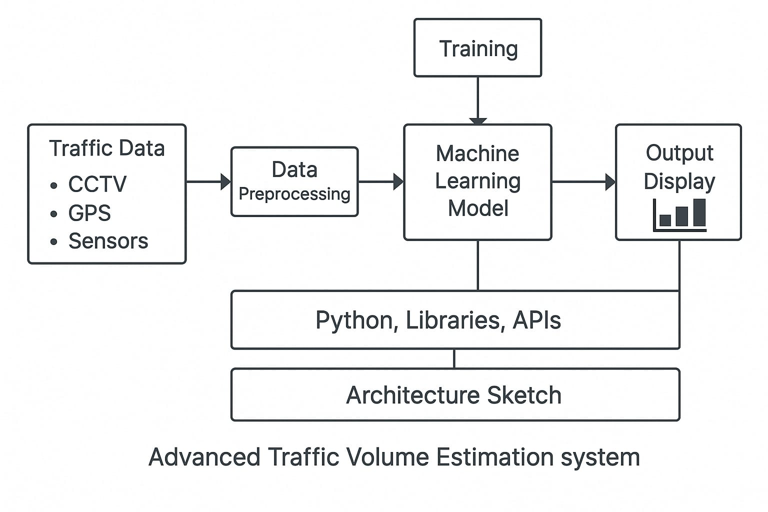
Machine Learning Pipeline Architecture
The visual above illustrates our robust machine learning pipeline, designed for efficient traffic volume estimation. Data flows from diverse sources into a preprocessing module, followed by feature engineering. The core ML models then process this data, with continuous feedback loops ensuring optimal performance and adaptation to real-world traffic patterns.

Slide 7
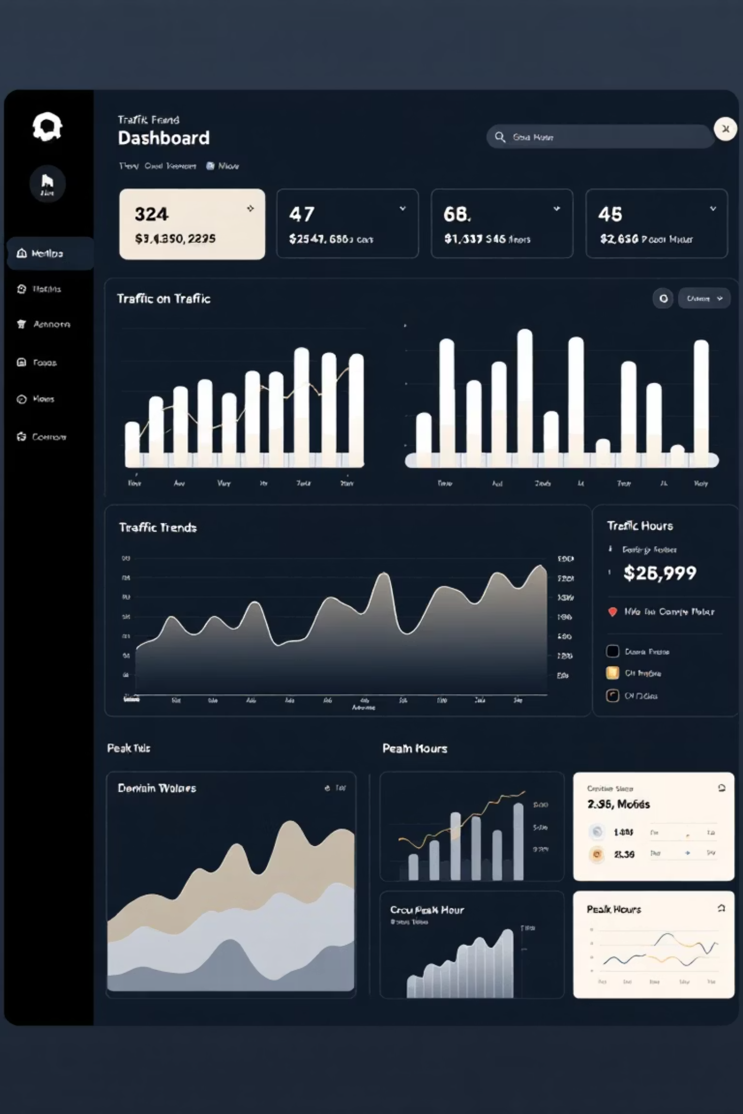
Results & Evaluation Metrics
0.92
15.7
28.1
R² Score
MAE (Vehicles)
RMSE (Vehicles)
Our model achieved a high R² score, indicating a strong correlation between predicted and actual traffic volumes.
The Mean Absolute Error (MAE) demonstrates high precision in our volume estimates, with minimal deviation.
The Root Mean Squared Error (RMSE) further confirms the model's accuracy and consistency across various scenarios.
TrafficTelligence meets its core objectives, delivering a scalable and highly accurate machine learning solution for real-time traffic volume estimation.

Slide 8





Challenges Encountered & Solutions Implemented
Data Quality Issues
Implemented robust data cleaning, normalization, and outlier detection algorithms to ensure data integrity and consistency.
Model Accuracy Plateaus
Enhanced predictive power through advanced feature engineering, ensemble methods, and hyperparameter tuning.
Performance Optimization
Adopted lightweight models and optimized inference pipelines for faster real-time processing without sacrificing accuracy.
Video Processing Lag
Mitigated latency by integrating MobileNet for efficient feature extraction and dynamic resolution downsizing.

Slide 9

Future Scope & Next Steps
Real-Time Deployment
Transitioning from prototype to live operation, leveraging real-time traffic feeds for continuous analysis.
System Integration
Seamless integration with existing city traffic control and smart city management platforms.
Predictive Enhancements
Incorporating advanced weather and event-based data for even more accurate and proactive predictions.
Web Dashboard Development
Creating an intuitive, scalable web dashboard for real-time monitoring and actionable insights for city officials.

Slide 10

Thank You!
We appreciate your time and attention today. TrafficTelligence is poised to transform urban mobility. We welcome your questions and look forward to discussing how our solution can benefit your city.

